Slide 1
Design Patterns (GOF) and their functional counterparts Paweł Beder
Notes:
What we can do with design patterns in java 8

Slide 2

Notes:
Where did those design patterns come from?
31 Oct 1994
Written before Java
Bible of OO Programming
Common Vocabulary
2017 – Functional Programming
Java 8 - 18 March 2014
Who programs in what?

Slide 3

Notes:
More user friendly
Java based
Updated to java8

Slide 4
GOF
Creational
Structural
Behavioural
Notes:
Three categories

Slide 5
Creational
Factory
Abstract Factory
Builder
Object Pool
Prototype
Singleton

Slide 6
Structural
Adapter
Bridge
Composite
Decorator
Facade
Flyweight
Proxy

Slide 7
Behavioral
Chain of Responsibility
Commmand
Interpreter
Iterator
Mediator
Memento
Obesrver
State
Stratety
Template
Visitor

Slide 8
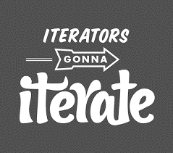

Slide 9
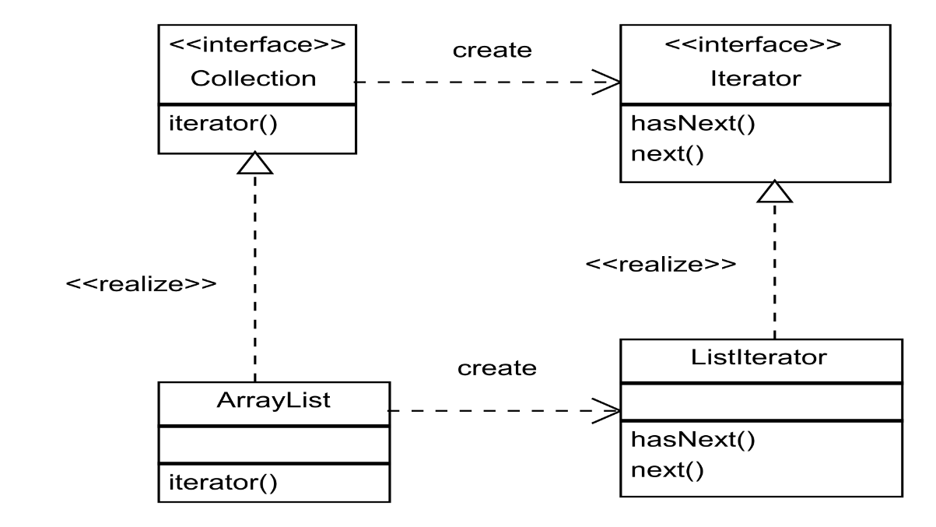
Iterator

Slide 10
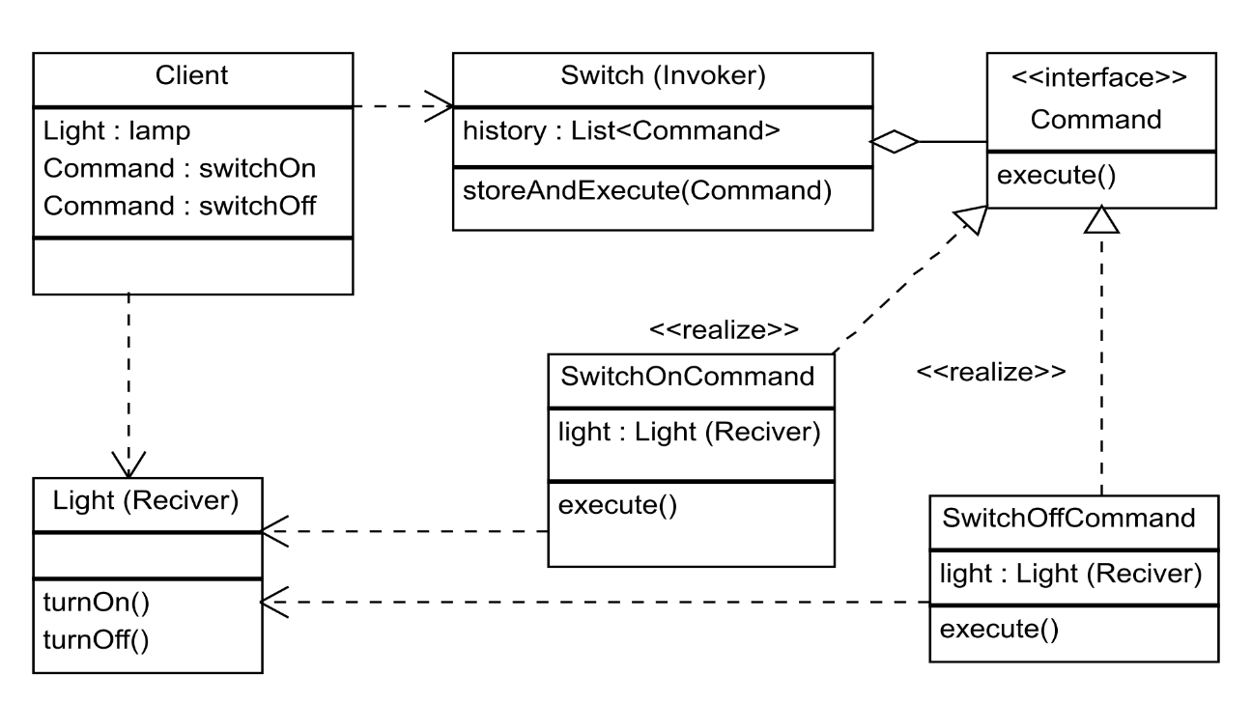
Command
Notes:
Encapsulate reference, method and parameters as an object for later invocation

Slide 11
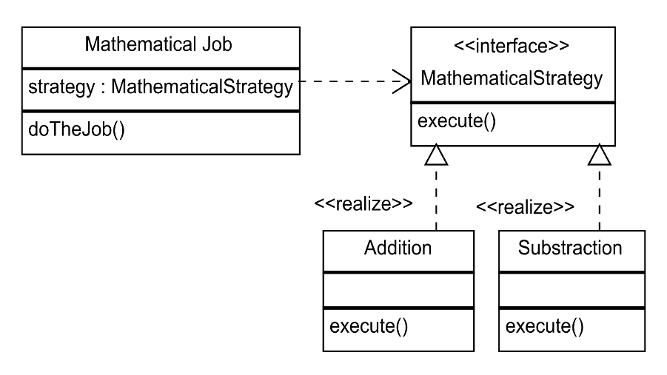
Strategy

Slide 12
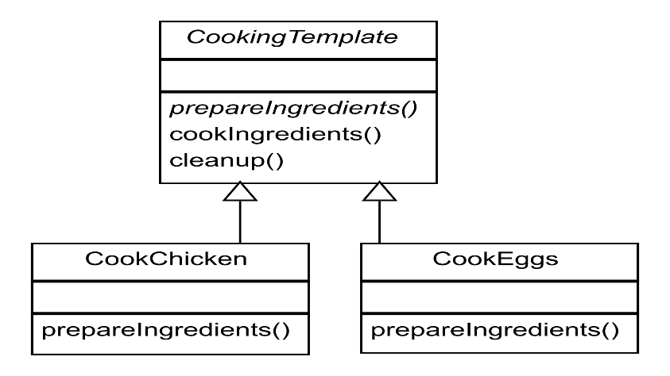
Template

Slide 13
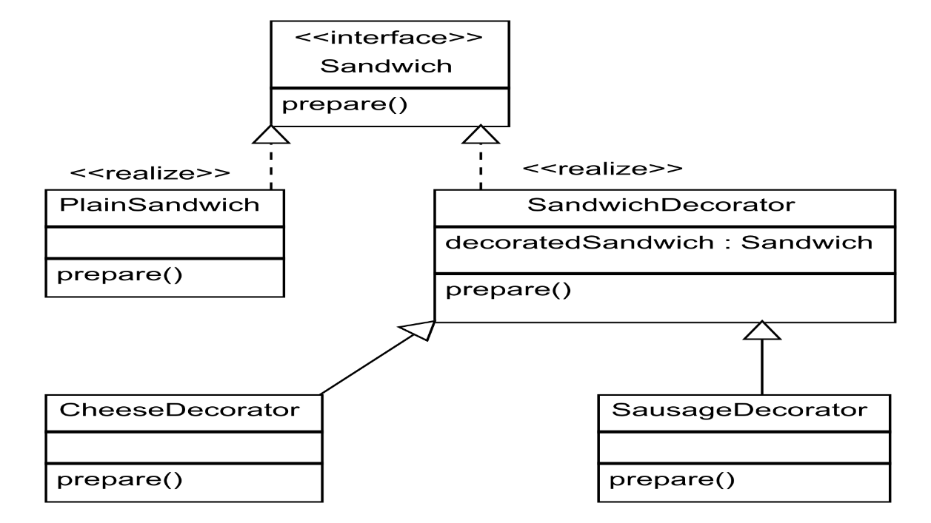
Decorator

Slide 14
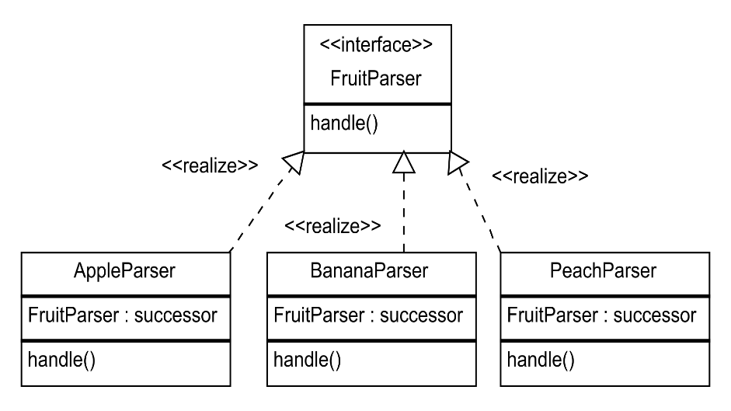
Chain of responsibility

Slide 15
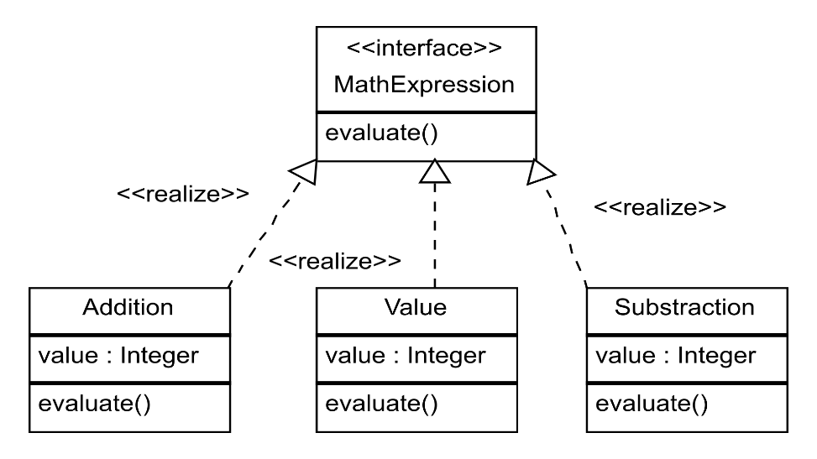
Interpreter

Slide 16
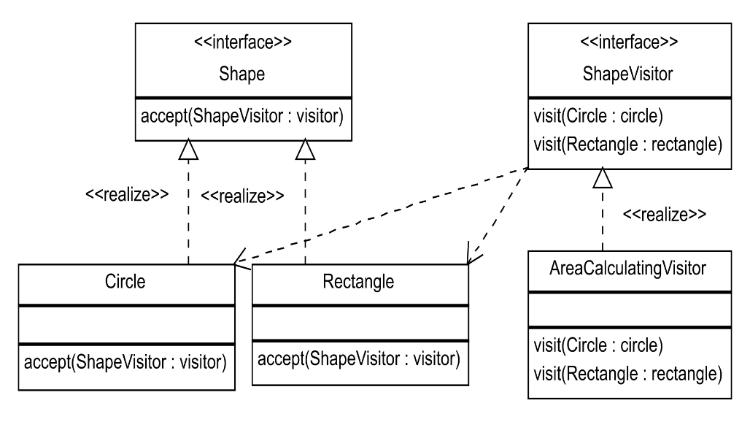
Visitor

Slide 17
Why go functional
It’s 2017 not 90’s
Less boilerplate, less typing
More expressive, readable code
Possibly more performant, immutable, parallel

Slide 18
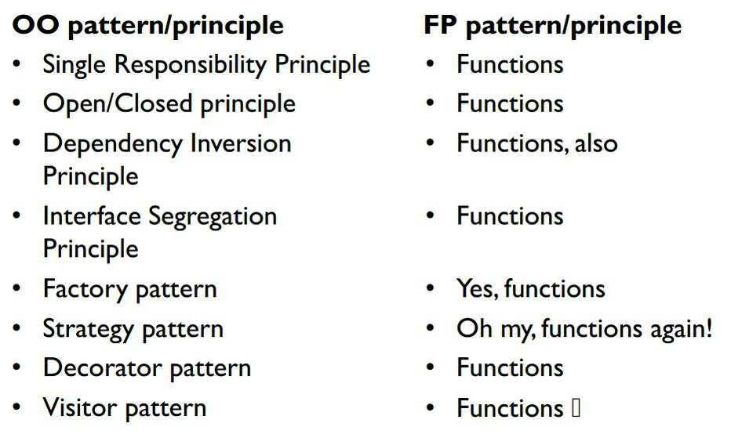
http://blog.cleancoder.com/uncle-bob/2014/11/24/FPvsOO.html

Slide 19
Thank You https://github.com/kinder112/FunctionalPatterns Design Patterns (GOF) and their functional counterparts Paweł Beder

